Slide 1

Predictive Analytics for Business Strategy

Slide 2
By the end of this class, you should be able to:
Explain and discuss what a proxy variable is.
Argue whether a particular proxy variable meets the required conditions (assumptions) for a valid proxy variable.
Explain why Zillow’s iBuyer program was ultimately unsuccessful.

Slide 3
Proxy variables

Slide 4
Working towards exogeneity
If we have observational data, but want to work towards having an exogenous model, what is the first tool you’ve learned that you can use to reduce your model’s endogeneity problem?

Slide 5
What if we don’t have data on confounding factors?
Unlike the control variable approach, what if no data on confounding factors?
This happens all the time.
A natural first choice: proxy variable(s).
These variables “proxy” for the confounding factor.
Proxy: highly correlated with the confounding factor.

Slide 6
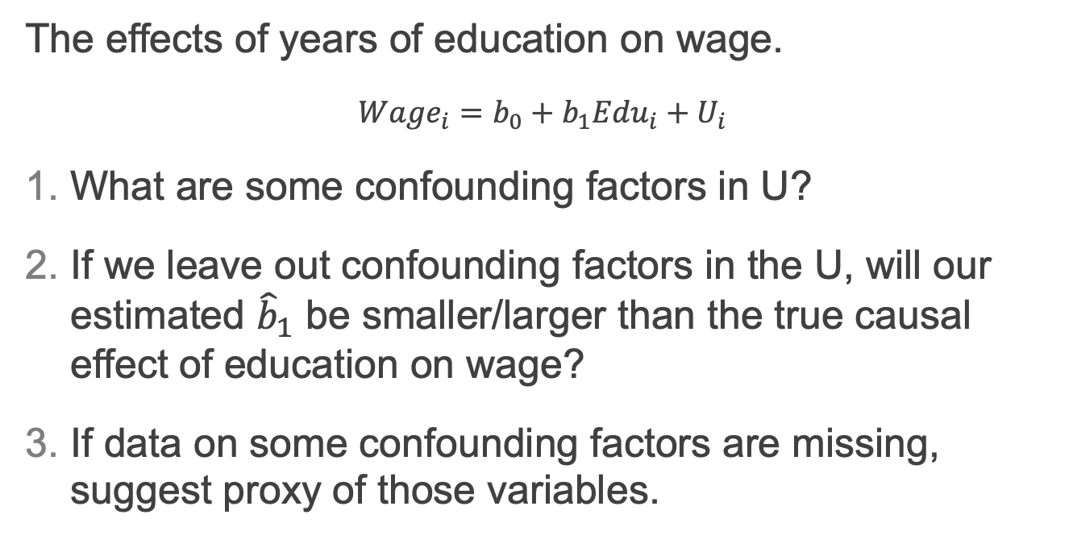
Effect of Education on Wage
The effects of years of education on wage.
$${Wage}_{i}=b_{0}+b_{1}{Edu}_{i}+U_{i}$$
What are some confounding factors in U?
If we leave out confounding factors in the U, will our estimated ${\hat{b}}_{1}$ be smaller/larger than the true causal effect of education on wage?
If data on some confounding factors are missing, suggest proxy of those variables.

Slide 7
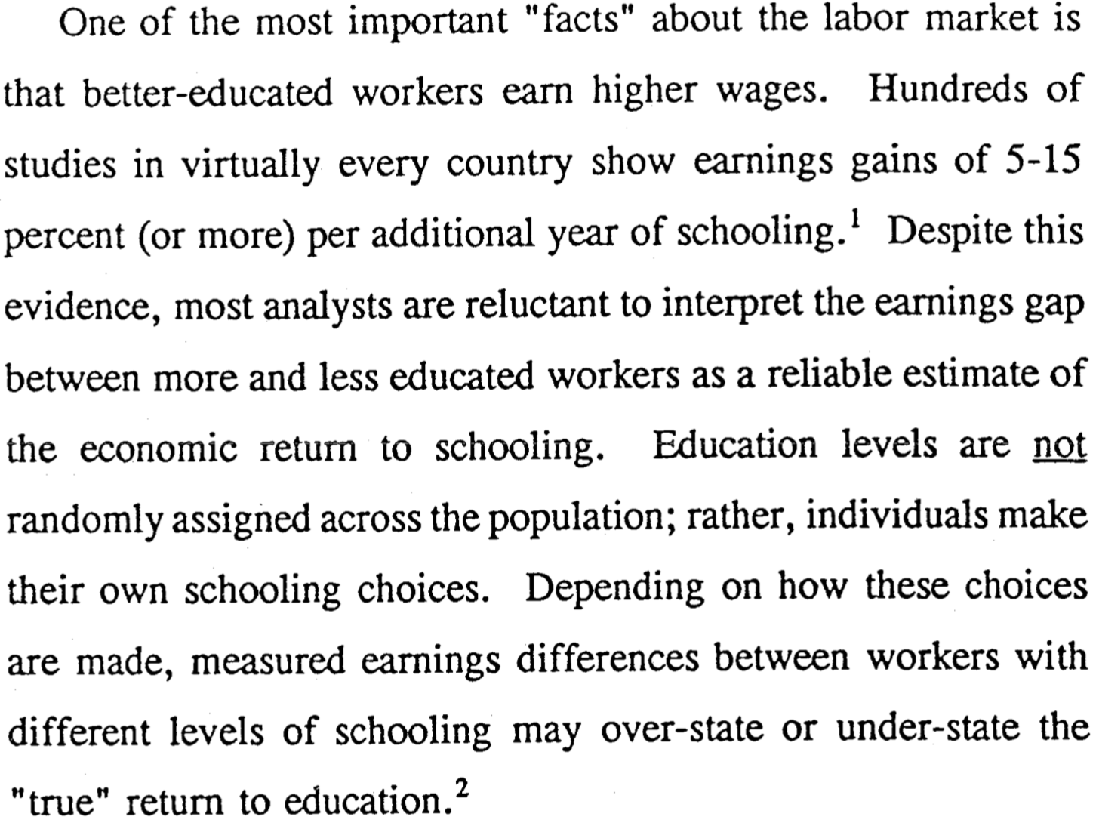
Card 1993

Slide 8
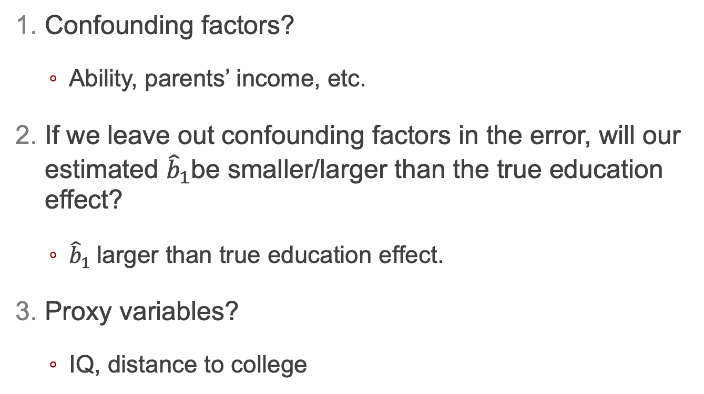
*Answers
Confounding factors?
Ability, parents’ income, etc.
If we leave out confounding factors in the error, will our estimated ${\hat{b}}_{1}$be smaller/larger than the true education effect?
${\hat{b}}_{1}$larger than true education effect.
Proxy variables?
IQ, distance to college

Slide 9
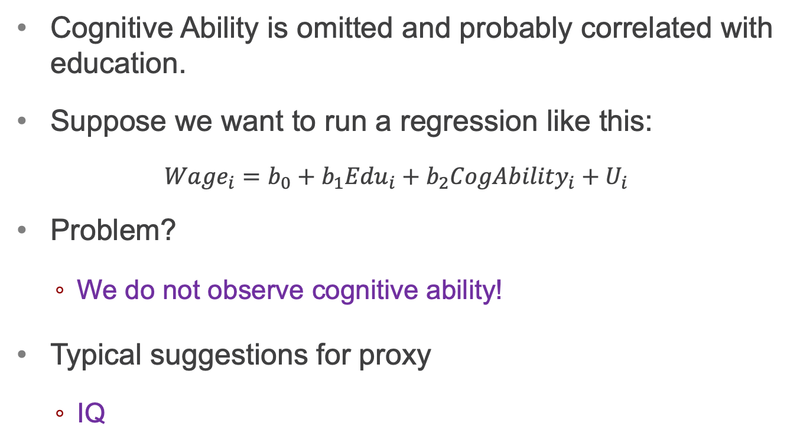
“Cognitive ability”, a major confounding factor
Cognitive Ability is omitted and probably correlated with education.
Suppose we want to run a regression like this:
$${Wage}_{i}=b_{0}+b_{1}{Edu}_{i}+b_{2}CogA{bility}_{i}+U_{i}$$
Problem?
We do not observe cognitive ability!
Typical suggestions for proxy
IQ

Slide 10
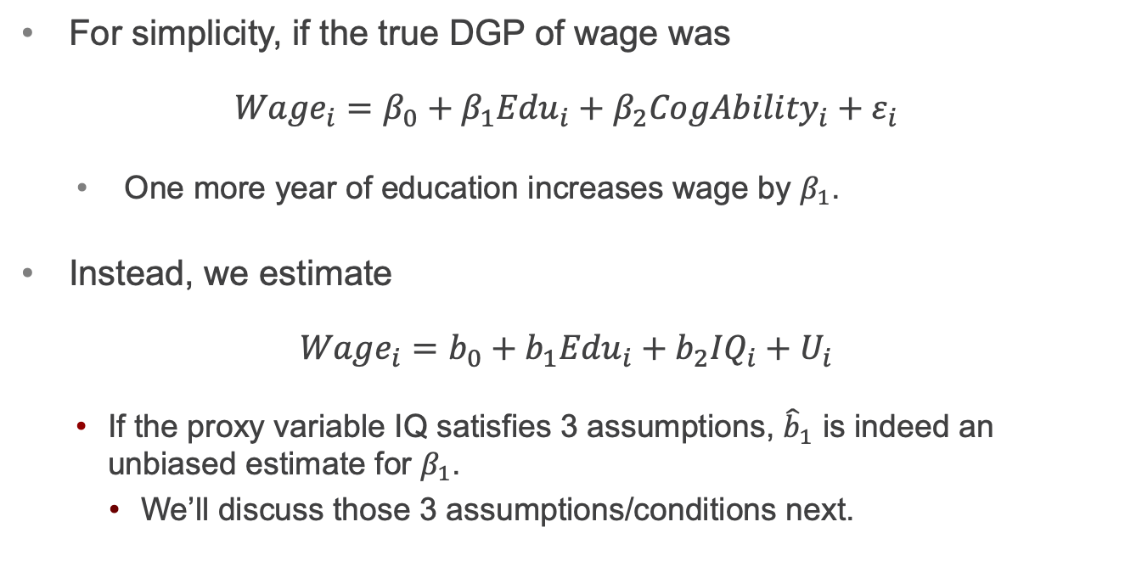
*IQ as a proxy of “cognitive ability”
For simplicity, if the true DGP of wage was
$${Wage}_{i}=β_{0}+β_{1}{Edu}_{i}+β_{2}{CogAbility}_{i}+ε_{i}$$
One more year of education increases wage by $β_{1}$.
Instead, we estimate
$${Wage}_{i}=b_{0}+b_{1}{Edu}_{i}+b_{2}{IQ}_{i}+U_{i}$$
If the proxy variable IQ satisfies 3 assumptions, ${\hat{b}}_{1}$ is indeed an unbiased estimate for $β_{1}$.
We’ll discuss those 3 assumptions/conditions next.

Slide 11
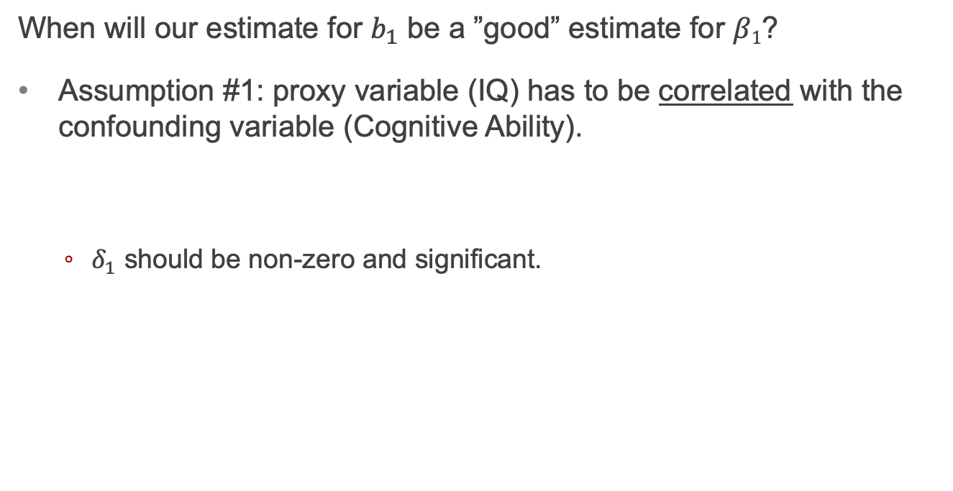

Assumption 1 for proxy variables
When will our estimate for $b_{1}$ be a ”good” estimate for $β1$?
Assumption #1: proxy variable (IQ) has to be correlated with the confounding variable (Cognitive Ability).
$δ_{1}$ should be non-zero and significant.
$${CogAbility}_{i}=δ_{0}+δ_{1}{IQ}_{i}+V_{i}$$
You can NOT empirically test whether the proxy satisfies assumption # 1.

Slide 12
Visualization of A#1?
CogAbility
A#1: IQ and ability are correlated, meaning B+C is not an empty set.
We observe IQ, but not CogAbility
A
B
E
C
F
IQ
G
edu
?

Slide 13
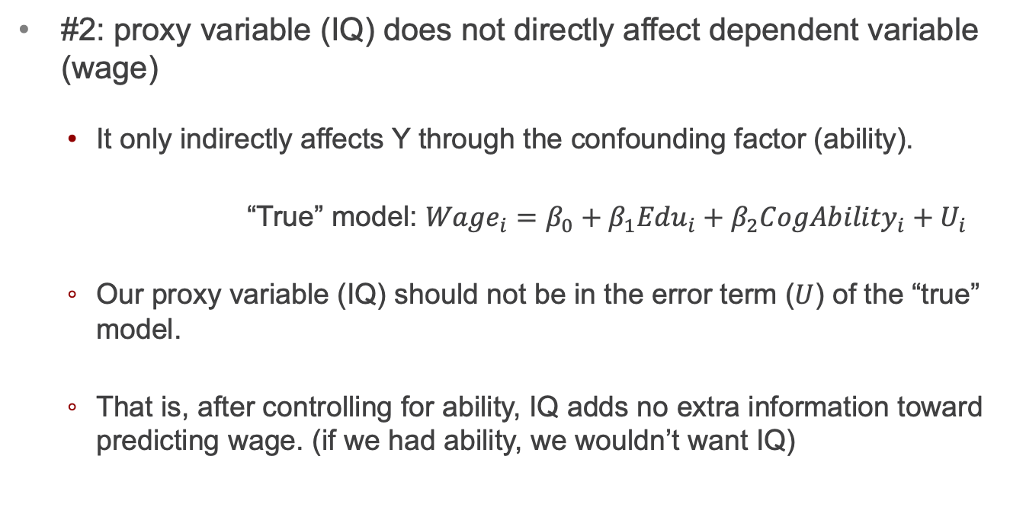
Assumption 2 for proxy variables
#2: proxy variable (IQ) does not directly affect dependent variable (wage)
It only indirectly affects Y through the confounding factor (ability).
“True” model: ${Wage}_{i}=β_{0}+β_{1}{Edu}_{i}+β_{2}{CogAbility}_{i}+U_{i}$
Our proxy variable (IQ) should not be in the error term ($U$) of the “true” model.
That is, after controlling for ability, IQ adds no extra information toward predicting wage. (if we had ability, we wouldn’t want IQ)
You can NOT empirically test whether the proxy satisfies assumption # 2.

Slide 14
Visualization of A#2?
CogAbility
A#2: IQ should not determine wage. IQ can affect wage only through ability.
C should be completely contained by ability.
Wage is Y
CogAbility not observed
IQ observed (proxy)
A
B
C
E
wage
IQ
?

Slide 15
Parents’ income as proxy for ability
Discuss whether parents’ income as a proxy for ability satisfies Assumption 1 and Assumption 2.
(if the targeted confounding factor is Cognitive Ability)

Slide 16
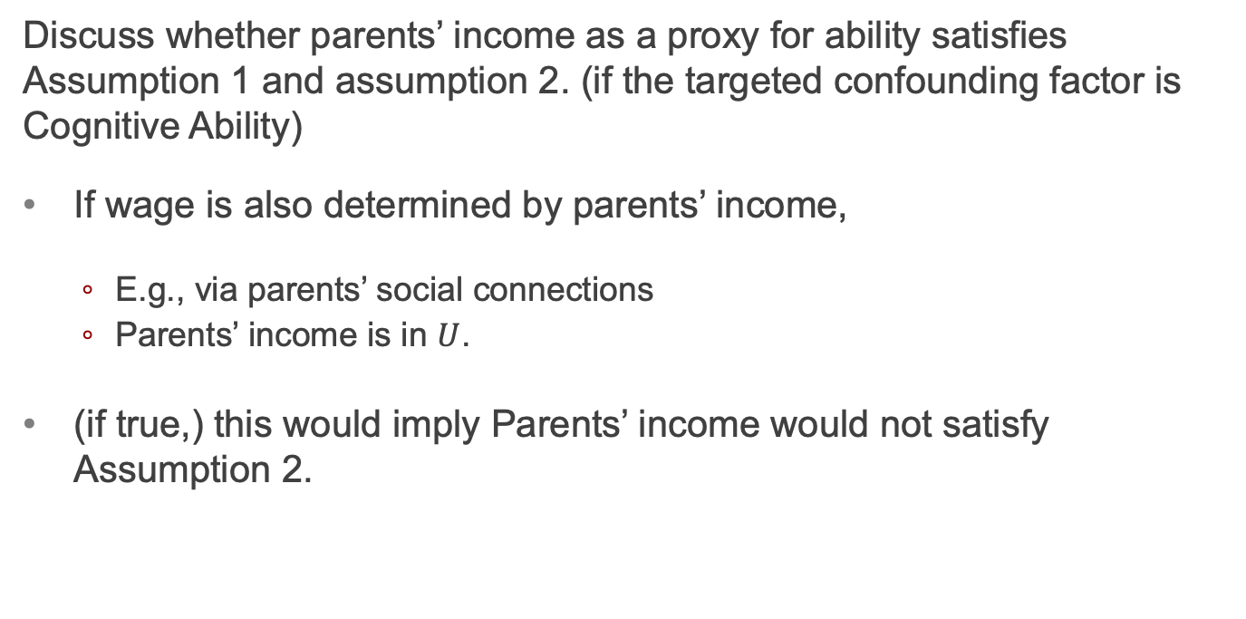
In class exercise
Discuss whether parents’ income as a proxy for ability satisfies Assumption 1 and assumption 2. (if the targeted confounding factor is Cognitive Ability)
If wage is also determined by parents’ income,
E.g., via parents’ social connections
Parents’ income is in $U$.
(if true,) this would imply Parents’ income would not satisfy Assumption 2.

Slide 17

Assumption 3 for proxy variables
#3: proxy variable (IQ) and any other regressors (education is the only other one here) are uncorrelated with the other factors ($V$) that determine the omitted variable (cognitive ability).
Neither education nor IQ are correlated with $V_{i}$.
$${CogAbility}_{i}=δ_{0}+δ_{1}{IQ}_{i}+V_{i}$$
You can NOT empirically test whether the proxy satisfies assumption #3.

Slide 18
Estimating Demand: Effect of price on quantity demanded for solar panels

Slide 19
Price Discrimination
What is price discrimination and why do firms try to engage in it?
If you were selling solar panels to consumers, how might you price discriminate?

Slide 20
Demand for Solar Panels
If we are estimating demand for solar panels, we want to know the causal impact of price on quantity demanded for solar panels.
What confounding factors should we worry about? (4 questions)

Slide 21
Demand for Solar Panels
If we are estimating demand for solar panels, we want to know the causal impact of price on quantity demanded for solar panels.
What confounding factors should we worry about? (4 questions)
(High) Price
Locations with/without high price
Differences: Income, concern for environment
In U? yes and yes

Slide 22
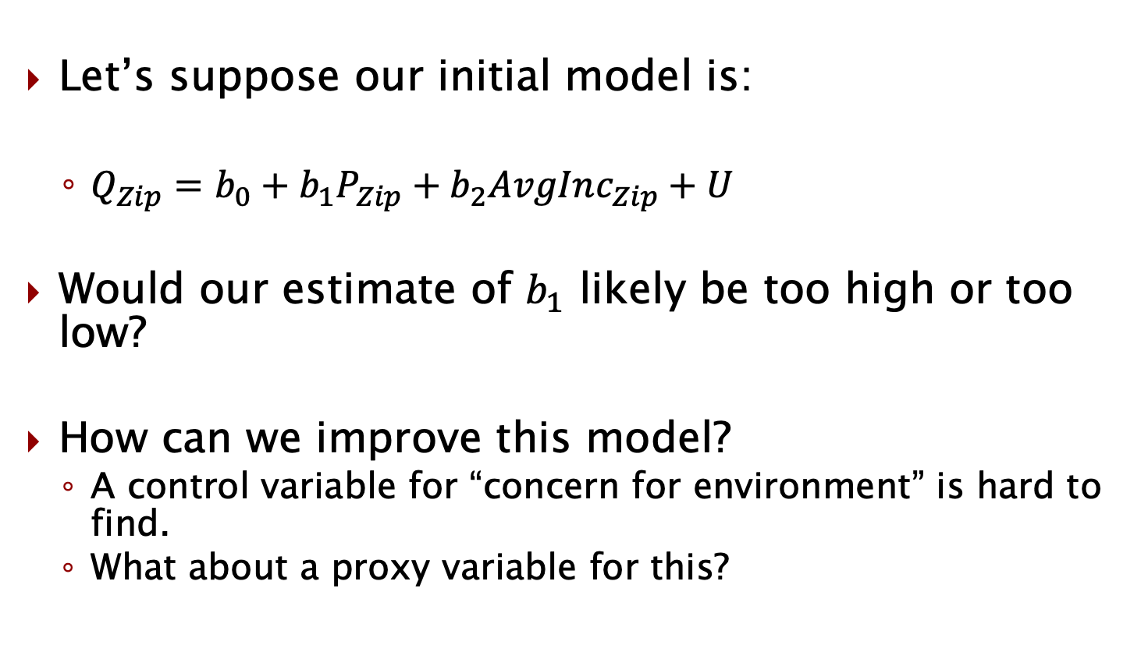
Initial demand estimation model
Let’s suppose our initial model is:
$Q_{Zip}=b_{0}+b_{1}P_{Zip}+b_{2}AvgInc_{Zip}+U$
Would our estimate of $b_{1}$ likely be too high or too low?
How can we improve this model?
A control variable for “concern for environment” is hard to find.
What about a proxy variable for this?

Slide 23
Adding a proxy
Does the following proxy variable satisfy all 3 assumptions for a proxy variable?
% of voters in zip code registered with Green Party

Slide 24
Adding a proxy
Does the following proxy variable satisfy all 3 assumptions for a proxy variable?
% of voters in zip code registered with Green Party
Correlated with concern for environment
% voters Green does not directly impact solar demand
If we regress concern for environment on % voters green, there are no confounding factors

Slide 25
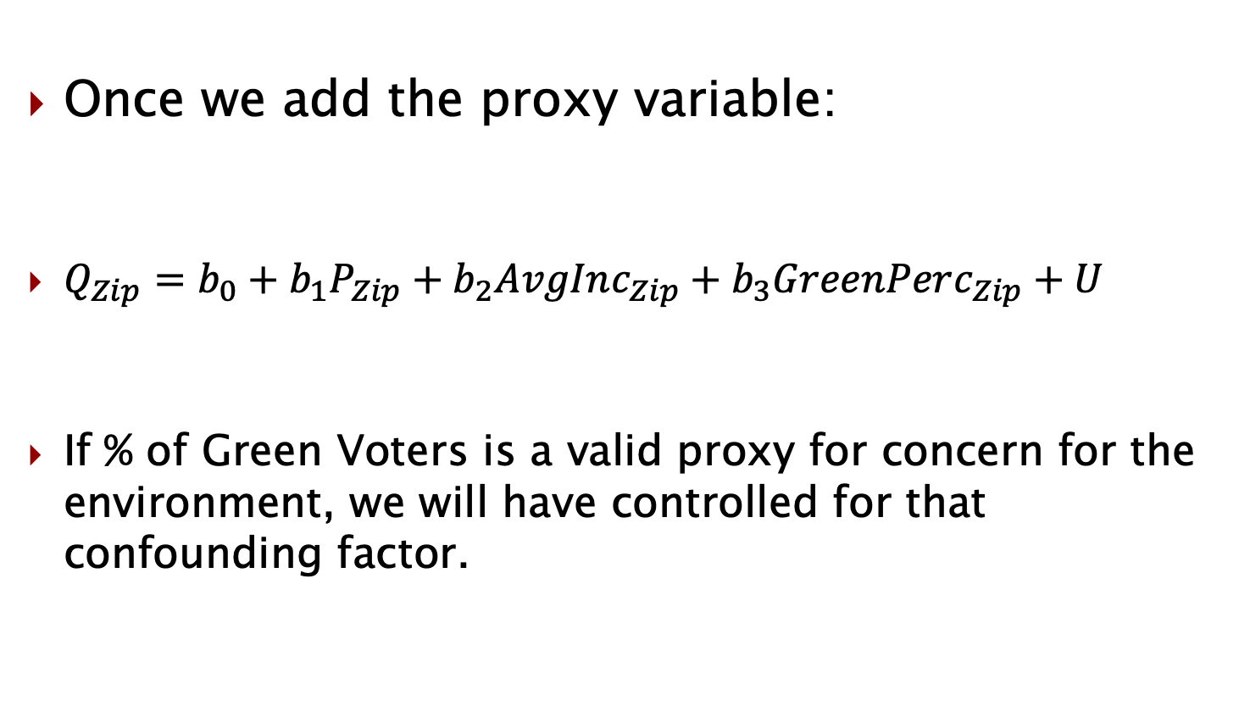
Adding a proxy
Once we add the proxy variable:
$Q_{Zip}=b_{0}+b_{1}P_{Zip}+b_{2}AvgInc_{Zip}+b_{3}GreenPerc_{Zip}+U$
If % of Green Voters is a valid proxy for concern for the environment, we will have controlled for that confounding factor.

Slide 26
A Few More Examples of Proxy Variables
Have previously started a business as proxy for entrepreneurial ability.
Widths of tree rings as proxy for historical environmental conditions
Per-capita GDP as a proxy for quality of life
Years of education and/or GPA as a proxy for cognitive ability

Slide 27
What’s in E?: Zillow iBuying program (RIP…)

Slide 28
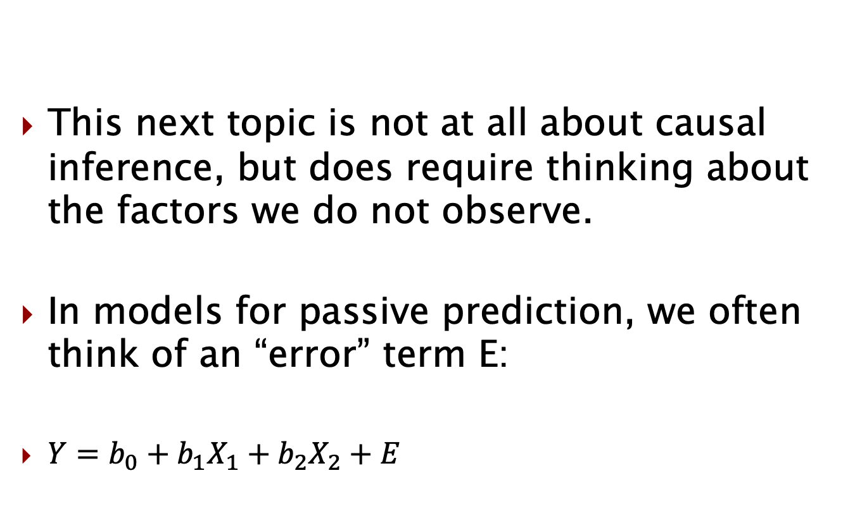
What’s in E?
This next topic is not at all about causal inference, but does require thinking about the factors we do not observe.
In models for passive prediction, we often think of an “error” term E:
$Y=b_{0}+b_{1}X_{1}+b_{2}X_{2}+E$

Slide 29
What’s in E?:
Zillow iBuying program
(RIP…)

Slide 30

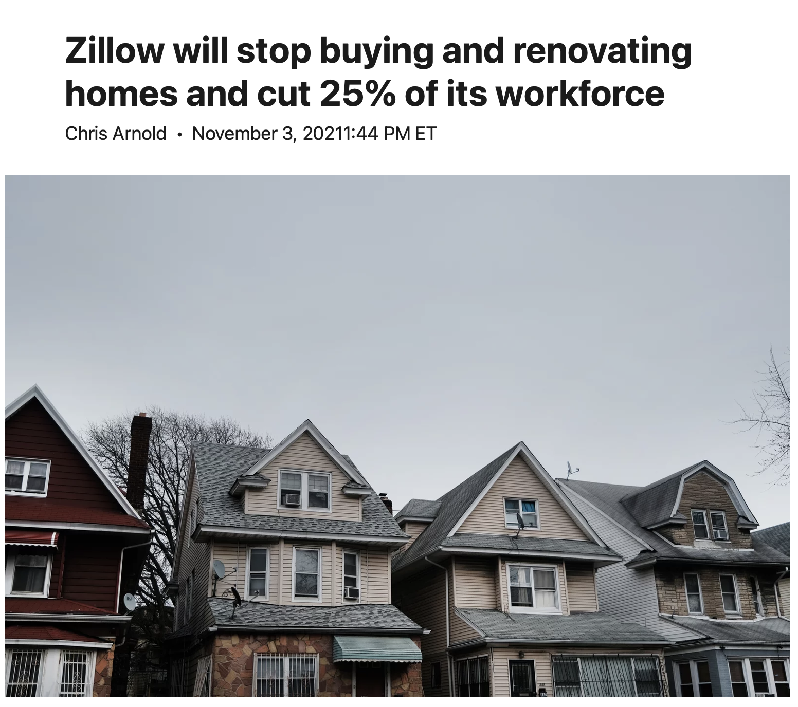
Zillow’s iBuyer

Slide 31
Zillow’s “Zestimate”
When Zillow estimates the price of a home, which are they doing?
Active prediction
Passive prediction

Slide 32
Zillow iBuyer
Roughly what is/was iBuyer by Zillow?

Slide 33
What’s in E?
Zillow has lots of data on:
Recent trends
Neighboring properties
Lots of property-specific data (# br, # ba, sf, etc.)
Tons of factors that might impact the price
What factors in a home price don’t they observe?

Slide 34
What’s in E?
Zillow has lots of data on:
Recent trends
Neighboring properties
Lots of property-specific data (# br, # ba, sf, etc.)
Tons of factors that might impact the price
Let’s suppose there’s a single factor in U that is hard to control for – “curb appeal”.
Likely there are other factors too.

Slide 35
Curb appeal
If everything in the DGP other than curb appeal can be controlled for, what impact does this have on the following:
Zillow’s ability to passively predict home prices?
Would they likely get this wrong on average?

Slide 36
Correlation with something in E
Suppose “curb appeal” is correlated with home size.
That’s fine, it just means that we’re attributing the (correlational) effect of curb appeal on price to home size.
But since it’s just passive prediction, it doesn’t matter.

Slide 37
Will Zillow get the home price exactly right?
Do you think Zillow gets the home price exactly right?
Does it need to if it wants to buy and sell homes?

Slide 38
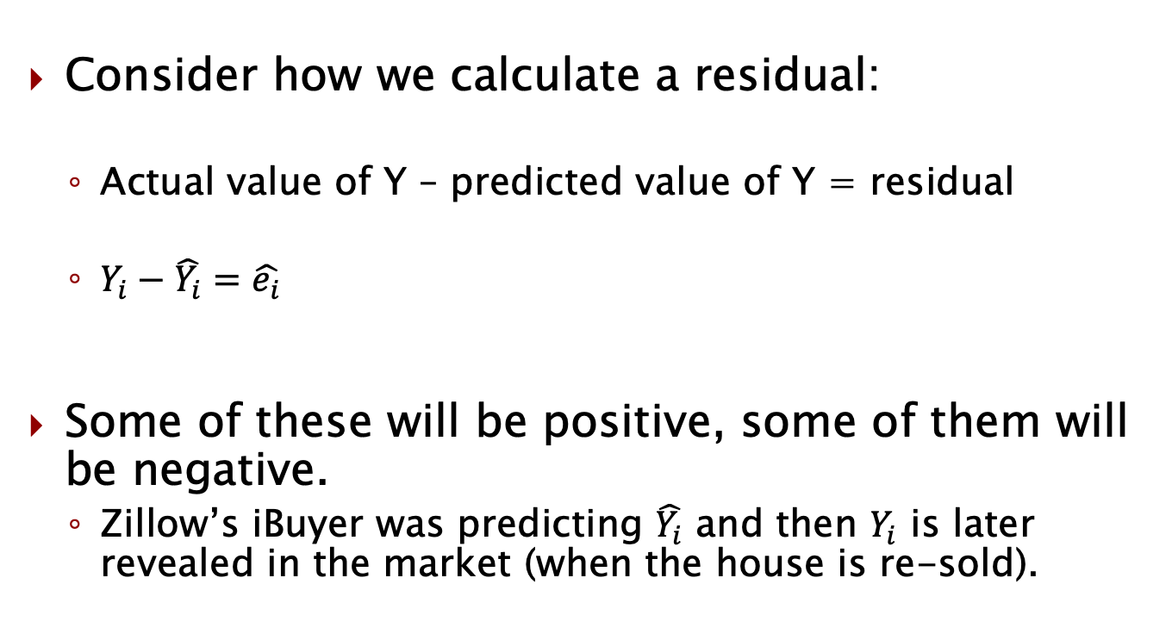
Residual
Consider how we calculate a residual:
Actual value of Y – predicted value of Y = residual
$Y_{i}−\hat{Y_{i}}=\hat{e_{i}}$
Some of these will be positive, some of them will be negative.
Zillow’s iBuyer was predicting $\hat{Y_{i}}$ and then $Y_{i}$ is later revealed in the market (when the house is re-sold).

Slide 39
What does the seller know?
Zillow has to first buy a home from a prospective seller.
What is a reason someone might sell to Zillow?

Slide 40
What does the seller know?
Zillow has to first buy a home from a prospective seller.
What is a reason someone might sell to Zillow?
Avoid hassle
Like the offer
REALLY LIKE THE OFFER!

Slide 41
Positive or negative residual
Let’s suppose prospective sellers all have a pretty good idea of what their home is worth.
When will they accept an offer from Zillow?
When the residual in Zillow’s model is positive?
When the residual in Zillow’s model is negative?

Slide 42
Winner’s curse
While it is possible that some people may sell to Zillow to avoid the hassle of fixing up their home to sell.
And Zillow may be more efficient at this and earn a profit on that difference in efficiency.
It is likely that most sellers sell to Zillow because they know the offer is too good and that Zillow has overestimated the home value.
Who likely won’t sell to Zillow? (or OpenDoor, OfferPad)

Slide 43
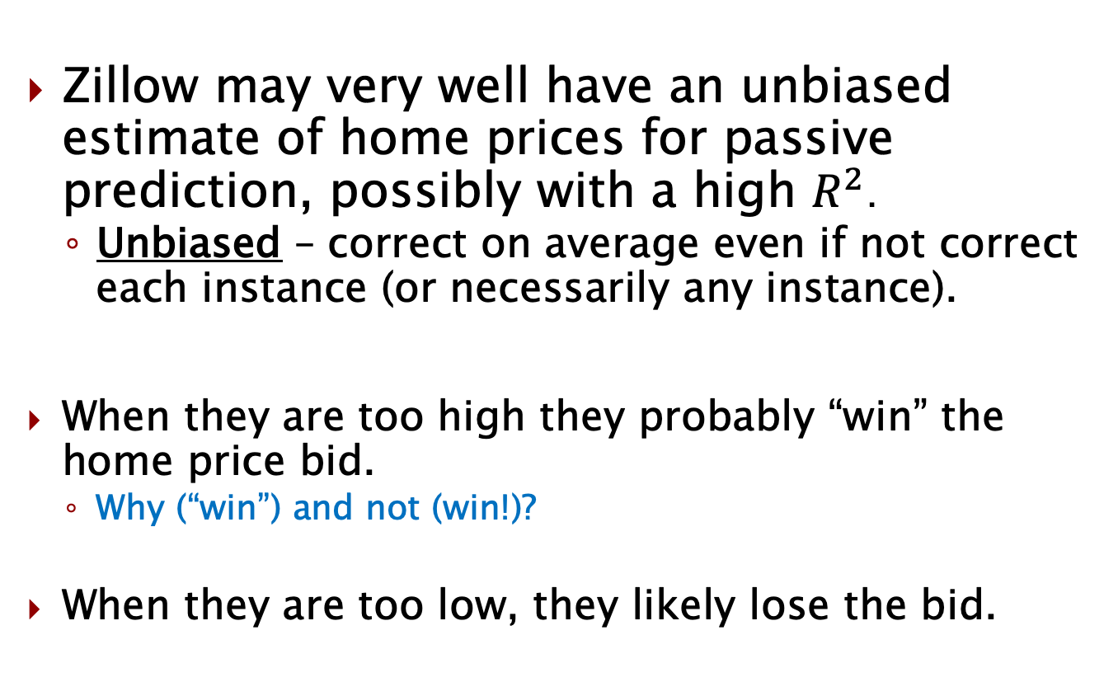
Zillow wrap-up
Zillow may very well have an unbiased estimate of home prices for passive prediction, possibly with a high $R^{2}$.
Unbiased – correct on average even if not correct each instance (or necessarily any instance).
When they are too high they probably “win” the home price bid.
Why (“win”) and not (win!)?
When they are too low, they likely lose the bid.

Slide 44
Announcements/reminders
Problem Set 3 due Sunday
Next week:
Class on Monday
Final exam on Wednesday on your own during class time
You have 80 minutes (out of 90 minute window) to take exam
20 questions on Canvas
18 multiple choice questions
2 short answer (similar to “why?/explain” questions from homework)

